Slide 1
Lecture 4 Plotting data
Trevor A. Branch
FISH 552 Introduction to R

Slide 2
Recommended reading
R graphics 2nd Edition (Paul Murrell, 2011)
Chapters 1 and 2
Chapter 1 of first edition here:
https://www.stat.auckland.ac.nz/~paul/RGraphics/rgraphics.html
R code available for all plots in 2nd edition:
https://www.stat.auckland.ac.nz/~paul/RG2e/

Slide 3
Projects in RStudio
Getting R to figure out where the files are (directories) is key when reading in data from files
RStudio has projects which do this in a very slick manner
You can store different analyses in different projects and quickly switch between them
Each project has a separate set of .r files that are open, and a separate R workspace (saved objects in console)

Slide 4
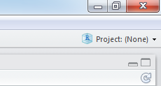
Using projects
Click on top-right option
Choose "Create Project" -> "Existing Directory" (or "New Project" if a directory does not exist)
Select a directory, e.g. "Lectures" for me
The project will be saved as a file in that directory called "Lectures.Rproj"
Opening that will open the RStudio project
Automatically sets the R working directory to that directory

Slide 5
In-class exercise (singly)
Create a Project in your U:/username directory
Download from the course website the file "primates.csv", and save it into the same directory
Create a new R script file "Lecture 4.r" and save it (in the same directory)
Add R code to the script file to read in the data file
> read.table(file="dat_df1.dat", header=T)
id age sex
1 31 12 M
2 62 18 F
3 50 20 F

Slide 6
Graphics in R: overview
There are several distinct ways of doing graphics in R
base graphics (changes to layout are fairly easy, highly modifiable)
lattice (used less now)
ggplot2 (good for multipanel plots, quick alternative views of data, changes to basic layout can be difficult)
I almost exclusively use base graphics, and will teach only this here
In FISH 554 Beautiful Graphics in R (Winter) I teach how to make complex and beautiful figures

Slide 7
Base graphics: plot()
Plot is the generic function for plotting R objects
points, lines, etc.
Read in the "primates.csv" data
> primates <- read.csv(file="Data/primates.csv", header=T)
> primates
X Bodywt Brainwt
1 Potar monkey 10.0 115
2 Gorilla 207.0 406
3 Human 62.0 1320
4 Rhesus monkey 6.8 179
5 Chimp 52.2 440

Slide 8
Three ways to plot
> plot(x = primates$Bodywt, y = primates$Brainwt)
> plot(Brainwt ~ Bodywt, data = primates)
> attach(primates)
> plot(x = Brainwt, y = Bodywt)
> detach(primates)
My preferred way
Sometimes used
Confusing: in the second line, where did object Brainwt come from?

Slide 9
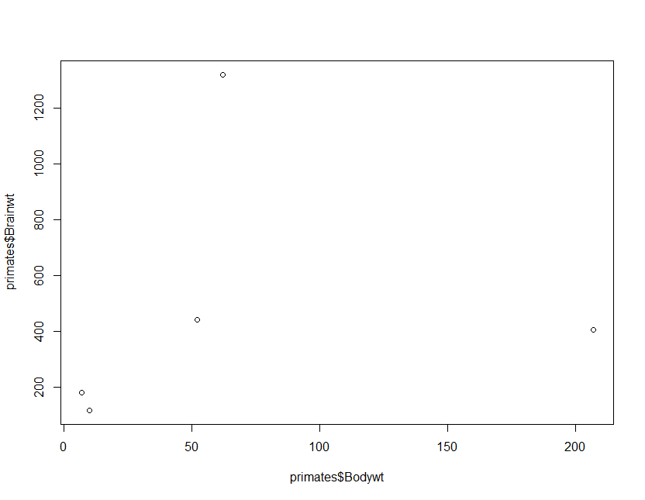
To be frank, this plot is a little boring!

Slide 10
Labels on the axes
By default R uses the name of the variables as axis labels
Use the xlab and ylab options to change the labels
plot(x = primates$Bodywt, y = primates$Brainwt,
xlab = "Body weight (kg)",
ylab = "Brain weight (g)")

Slide 11
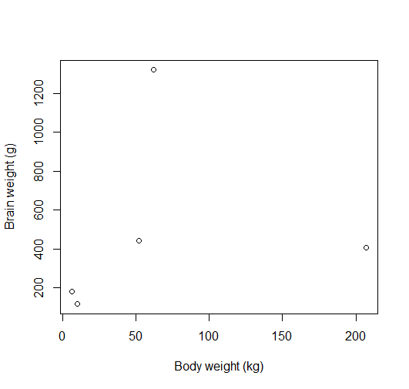

Slide 12
Limits of the axes
By default, R chooses x and y limits that are just larger (4%) than the range of your data
May or may not include zero
To change the default x and y values use xlim and ylim
plot(x = primates$Bodywt, y = primates$Brainwt,
xlim=c(0,300), ylim=c(0,1400))

Slide 13
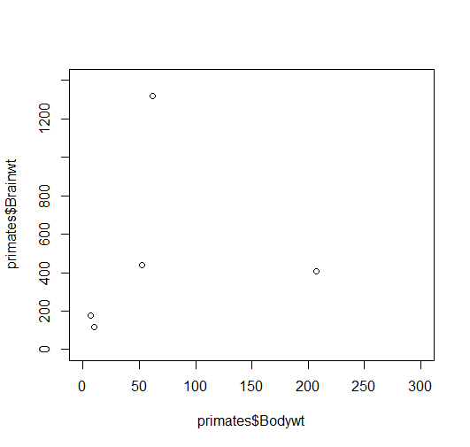

Slide 14
Remove space around zero
My pet peeve: R adds space between the axis and 0
This makes true zeros look like they are non-zeros
To remove this, use xaxs="i" and yaxs="i" together with xlim and ylim
plot(x = primates$Bodywt, y = primates$Brainwt,
xlim=c(0,300), ylim=c(0,1400),
xaxs="i", yaxs="i")

Slide 15
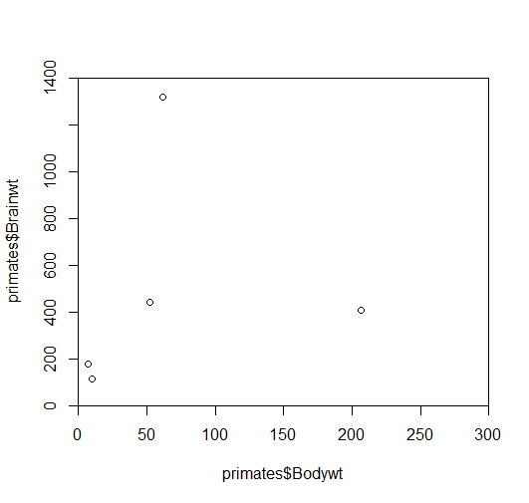

Slide 16
Using colors in R
Colors of points, lines, text etc. can all be specified
Colors can be applied to various plot parts
col (default color)
col.axis (tick mark labels)
col.lab (x label and y label)
col.main (title of the plot)
Colors can be specified as numbers or text strings
col=1 or col="red"
> plot(x = primates$Bodywt, y = primates$Brainwt,
+ xlim=c(0,300), ylim=c(0,1400),
+ xaxs="i", yaxs="i", col="blue")

Slide 17
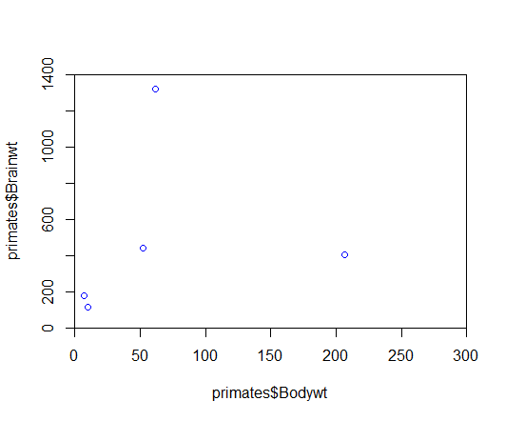

Slide 18
In-class exercise 1
Copy and paste the following command into your R script
plot(x = primates$Bodywt, y = primates$Brainwt,
xlim=c(0,300), ylim=c(0,1400),
cex=2, pch=19, col="blue")
Experiment with different color names: col="red"
Try different color numbers: col=1, col=2
Try a vector of color numbers: col=c(2,4)
Experiment with changing the values for cex and pch

Slide 19
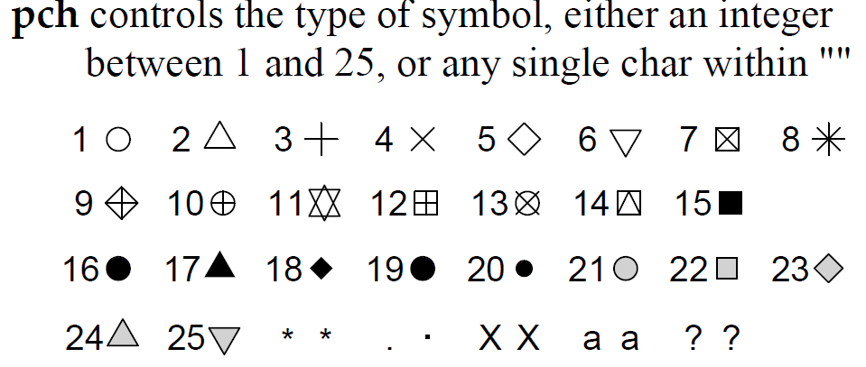
Controlling point characteristics
Default is an open circle (pch=1) of size 1 (cex=1)
pch short for plotting character
cex short for character expansion
Source: R Reference Card 2.0

Slide 20
Color naming
There are 657 named colors
colors()
point.colors <- c("red", "orange", "green", "blue",
"magenta")
plot(x = primates$Bodywt, y = primates$Brainwt,
xlim=c(0,300), ylim=c(0,1400),
cex=2, pch=19, col=point.colors)

Slide 21
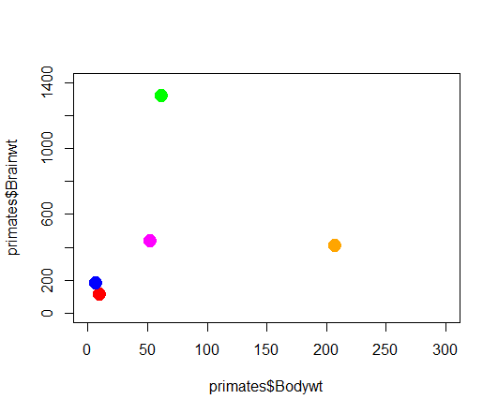

Slide 22
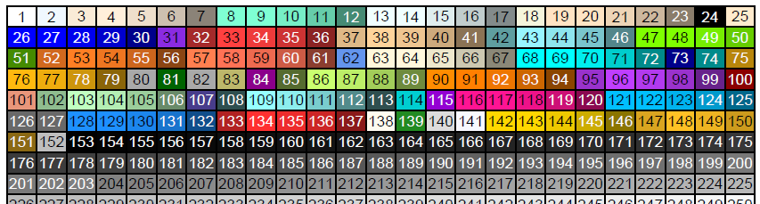
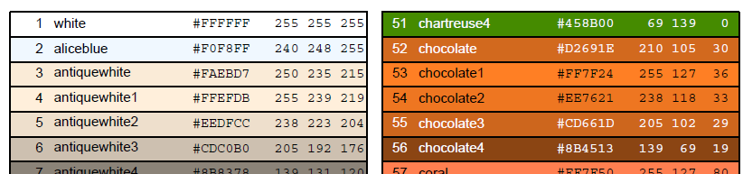
R color chart: keep handy http://research.stowers-institute.org/efg/R/Color/Chart/ColorChart.pdf
FISH 554 Beautiful Graphics in R: custom palettes, translucent colors, RGB or HSV colors, color blindness, divergent color schemes, hexadecimal, Color Brewer, etc.

Slide 23
Useful options for points
Useful code and options under ?points
Use pch=21 for filled circles, for example:
Specify circle color with col
Specify fill color with bg
plot(x = primates$Bodywt, y = primates$Brainwt,
xlim=c(0,300), ylim=c(0,1400),
cex=2, pch=21, col="black", bg="salmon")

Slide 24
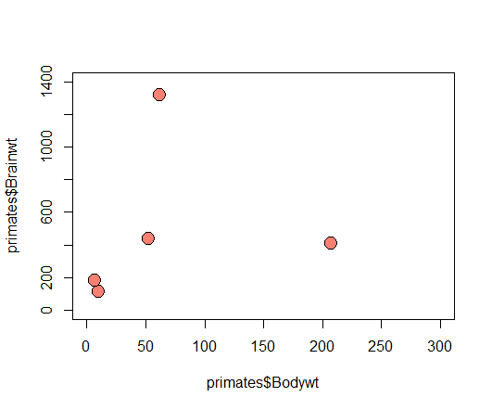

Slide 25
Full list of plot parameters: par()
If you ask for help on the plot() command using ?plot, only a handful of commands are listed
There are numerous extra commands listed under ?par that can be added to all plotting commands, not just plot()
Using par() by itself applies commands to multiple graphs
> par()
$xlog
[1] FALSE
...

Slide 26
Using par() for global changes avoid this whenever possible
Save default par values
old.par <- par()
Change to a new value
par(col.axis="red")
plot(x = primates$Bodywt, y = primates$Brainwt,
xlim=c(0,300), ylim=c(0,1400),
cex=2, pch=21, col="black", bg="salmon")
plot(1:3)
Restore defaults
par(old.par)
plot(1:3)

Slide 27
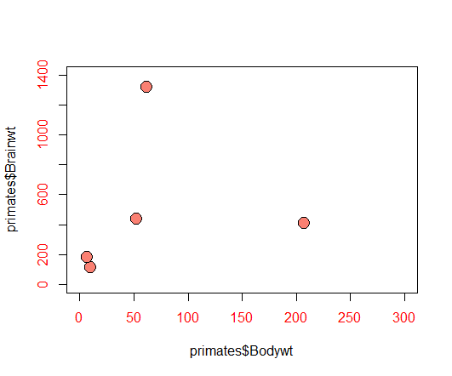

Slide 28

To return to default plotting
Selecting the Clear All command in the plotting window resets all figures and sets par() to the default values. Use this option when you have gone too far and can’t get back to a nice simple plotting screen.

Slide 29
Vector options for plotting
Many plotting options can handle vectors, each element applies to one point, are recycled
Different point characters: pch=1:5
Different point letters: pch=c("a","g","t","c")
Different colors: col=1:5
Different sizes: cex=1:5

Slide 30
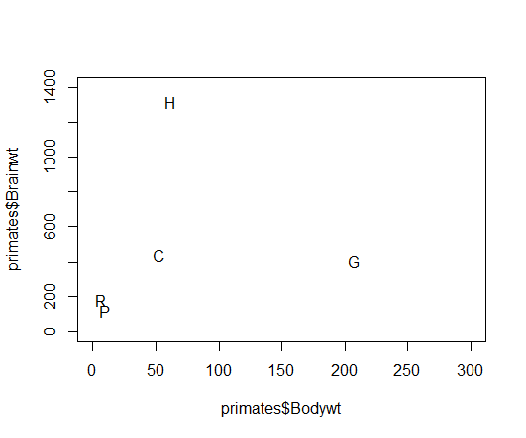
First letter of each primate’s name

Slide 31
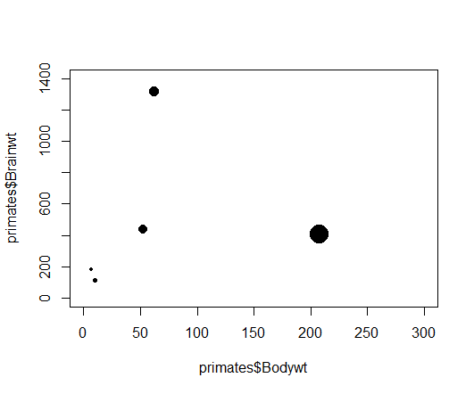
Circle size proportional to body weight

Slide 32
Adding legends
Legends do not use anything in the plot
Look up help on the legend function (?legend), note that most options in par() can be used too
legend(x="topright",
legend=primates[,1],
pt.bg=1:5,
pch=21:25,
bty="n")
also "bottomleft" etc., and can use x=100, y=100
vector of text strings
background color of points
vector of symbol type
no box type

Slide 33
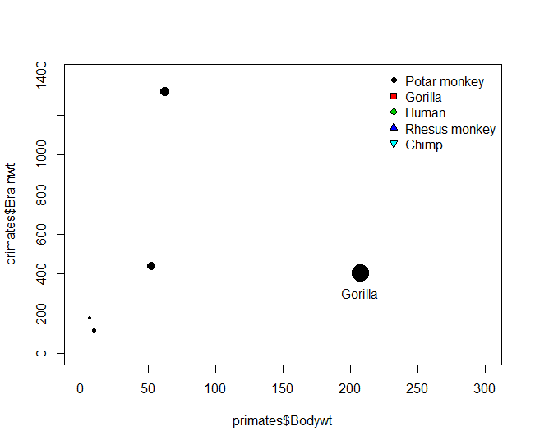
If you want the legend to correspond to the plot, you need to specify identical symbols, sizes, and colors for the plot and the legend

Slide 34
Axis properties
Tick mark labelling using yaxp and xaxp
c(min, max, number of spaces between intervals)
plot(x = primates$Bodywt, y = primates$Brainwt,
...
yaxp = c(0, 1500, 3))

Slide 35
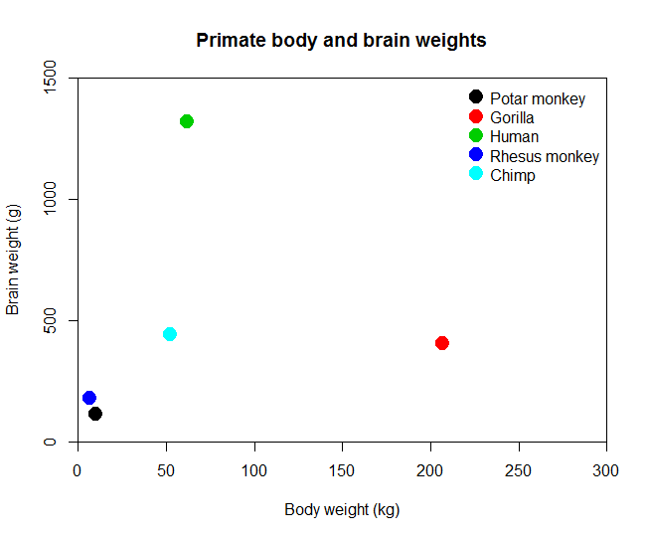
Hands-on exercise 2
Try to replicate as closely as possible this graph
Colors are 1:5
Note the axes
Figure out how to add a title

Slide 36
More advanced axis properties
For more control over axes, use the axis() function
First create the plot but suppress the x or y axis using xaxt="n" and yaxt="n"
Then add axes to whichever side they are needed
plot(x = primates$Bodywt,
y = primates$Brainwt,
...
yaxt = "n")
axis(side = 2, at = seq(0,1500,300),
labels = c(0,300,600,900,1200,">1500"))

Slide 37
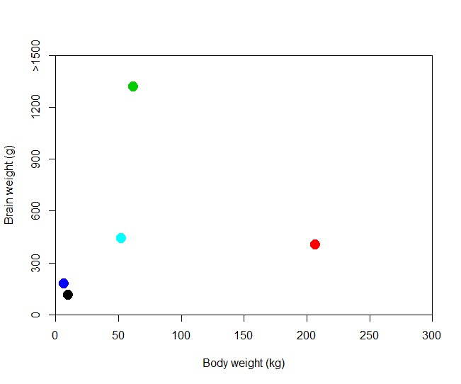

Slide 38
Adding text using locator()
Interactive function: click on the plot and it returns the x and y coordinates
> locator(1)
$x
[1] 207.6493
$y
[1] 305.7384
Add text at those coordinates
text(x=207, y=306, label="Gorilla")
Omit the 1 for multiple clicks, press <esc> to exit

Slide 39
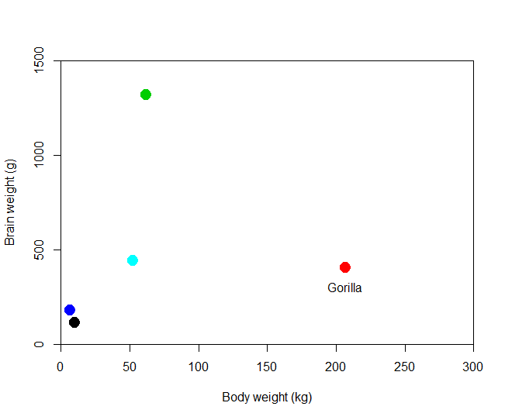

Slide 40
Labeling points using text()
Look up the help on ?text
Can use vectors for x, y, and the text strings
After creating the plot, call text()
pos=1 below
pos=2 to the left
pos=3 above
pos=4 to the right
text(x = primates$Bodywt, y = primates$Brainwt,
labels = primates[,1], pos=4)

Slide 41
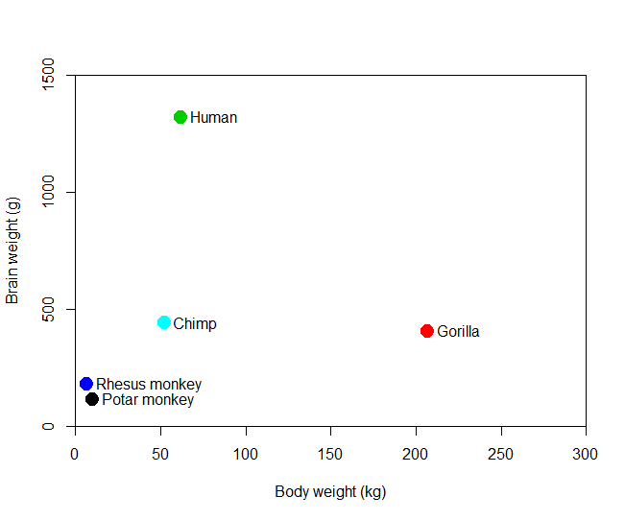

Slide 42
Interactive point labeling
If you don't want to label all your points but there are a few outliers
plot(x = primates$Bodywt, y = primates$Brainwt,
...)
identify(x = primates$Bodywt, y = primates$Brainwt,
labels = primates[,1], n = 2)
Click near n = 2 of the points

Slide 43
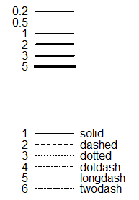
Points and lines
lwd values
?lines gives values for lty, the line types
For line widths use lwd
lty values

Slide 44
More plot types
In the plot() command, type specifies the type of plot to be drawn
"p" points
"l" lines
"b" both lines and points
"c" lines part alone of “b”
"o" overplotted
"h" histogram-like (or high-density) vertical lines
"s" stair steps
"n" for no plotting

Slide 45
Adding points or lines
You can add a series of points or lines to the current plot using points() and lines()
lines(x=seq(50,200,50), y=c(200,450,500,300),
type="b", lwd=3, lty=2)
points(x=seq(100,250,50), y=seq(100,250,50),
cex=3, pch=17)

Slide 46
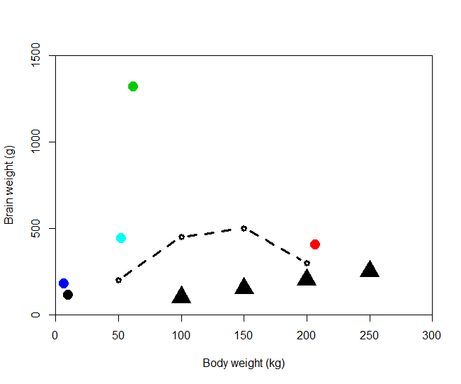

Slide 47
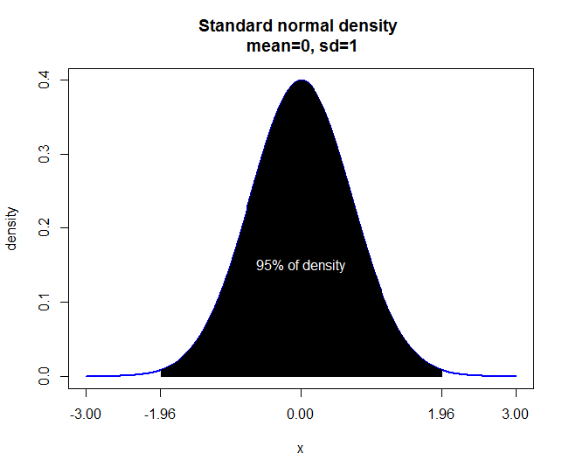
Hands-on exercise 3
The equation for the standard normal density is
exp(-x^2)/sqrt(2*pi)
Create the plot on the right to illustrate where 95% of the area falls:
-1.96 ≤ x ≤ 1.96
Hint: use type in two different ways

